Slide 1
Bump / Normal mapping
Advanced Graphics Programming

Slide 2
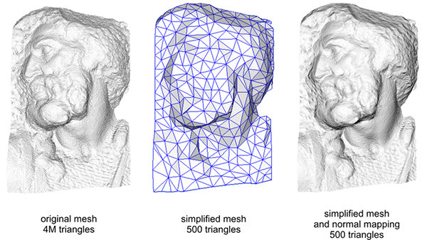
Much less polygons, same perceived quality
4M tris vs. 500 tris and they look the same!

Slide 3
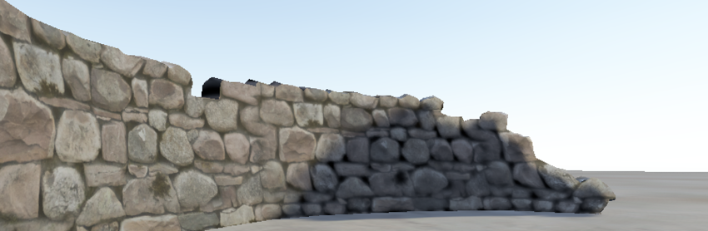
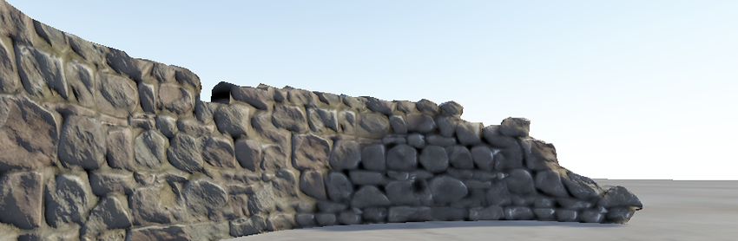
Same number of polygons...
Looks better!

Slide 4
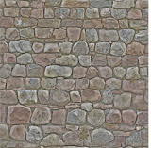
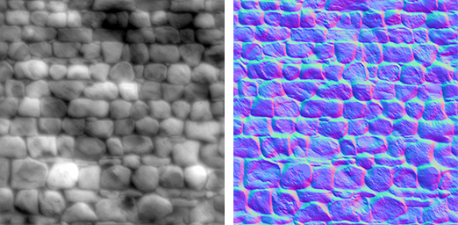
Texture mapping
Bump maps
Albedo
Height map
Normal map

Slide 5
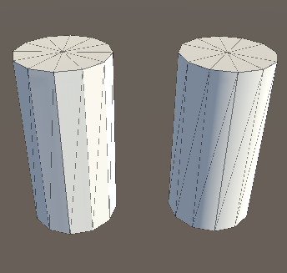
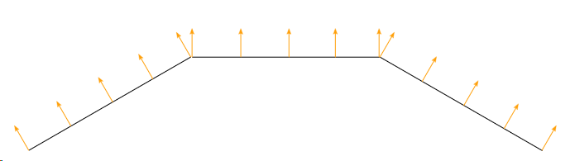
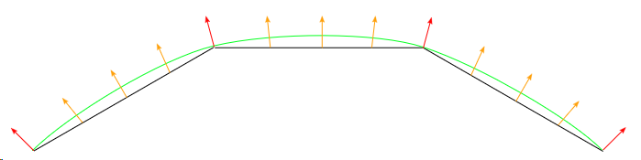
How does bump mapping work?
Per-face normals
Per-vertex normals

Slide 6
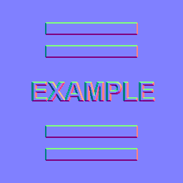
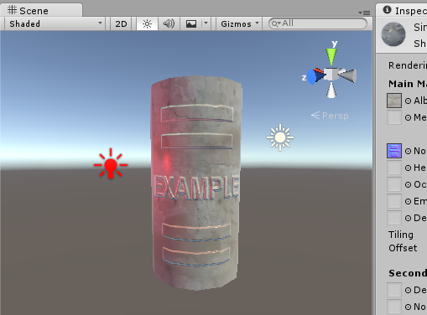
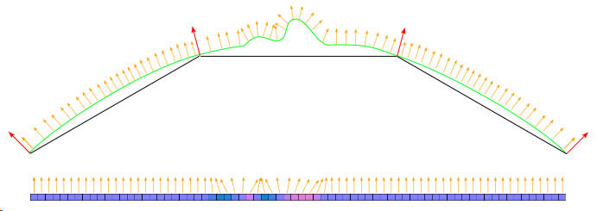
How does bump mapping work?
Input texture
(Uniform variable)
Fragment shader
(modifies per-fragment normals based on the mapped texels)

Slide 7

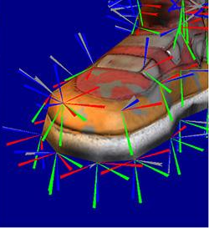
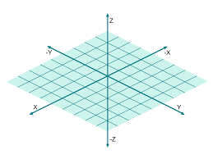
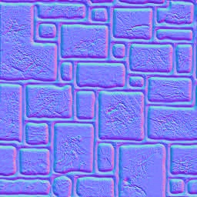
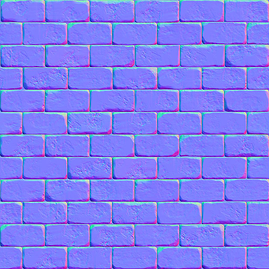
Why these blue-ish colours?
Normals are stored in a coord. system that is tangent to the mesh surface.
Tangent space
Defined per-vertex
Interpolated per-fragment
In this space, the surface normals roughly point towards the Z axis.

Slide 8
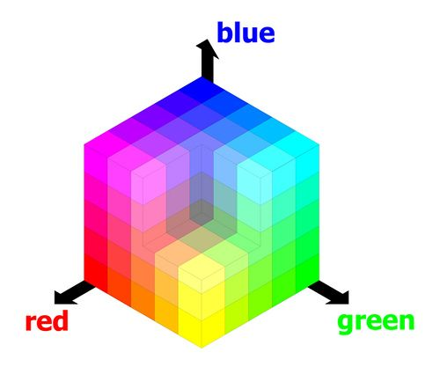
Why these blue-ish colours?
Surface normals are 3D vectors
Vector components are in range [-1, 1]
They need to be stored in color textures
RGB components are in range [0, 255]
Or in range [0, 1] in GLSL
3D vector - color conversion

Slide 9
Why these blue-ish colours?
Encoding
// XYZ to RGB conversion
color.r = normal.x * 0.5 + 0.5
color.g = normal.y * 0.5 + 0.5
color.b = normal.z * 0.5 + 0.5
// We store color in the texture
texture[u, v] = color

Slide 10
Why these blue-ish colours?
Decoding
(done in GLSL)
// We get color from the texture
color = texture[u, v]
// RGB to XYZ conversion
normal.x = (color.r - 0.5) * 2.0
normal.y = (color.g - 0.5) * 2.0
normal.z = (color.b - 0.5) * 2.0

Slide 11
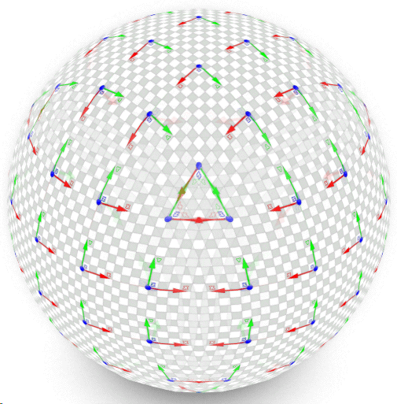
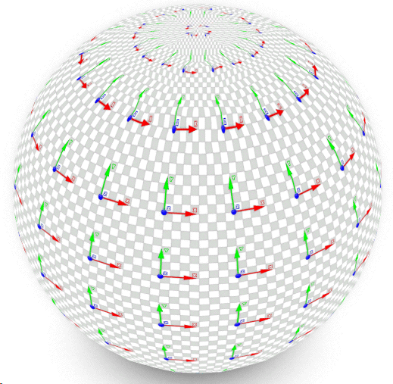
Tangent space matrix (TBN) - What is it?
Change of base matrix
From tangent space to local space
3x3 matrix
only defines rotations
Consist of 3 axes expressed in the local coordinate system of the object
X: Tangent
Y: Bitangent
Z: Normal (same old normal)
TBN Matrix
Define texture
orientation
Different texture mappings will generate different tangent space bases on the same model.

Slide 12



Tangent space matrix (TBN) - Usage
From tangent to local space
From local to tangent space
Inverse of TBN
If TBN is orthonormal…
inverse = transposed
Different texture mappings will generate different tangent space bases on the same model.

Slide 13
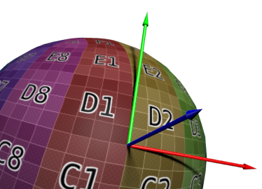
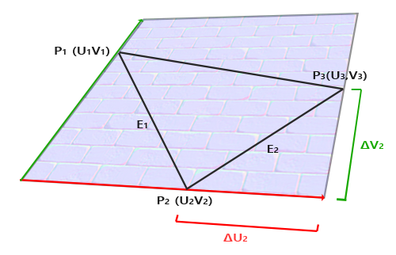
Tangent space matrix (TBN) - Calculation
So the X and Y axes of TBN (tangent and bitangent) depend on the texture mapping on the surface at each vertex.

Slide 14
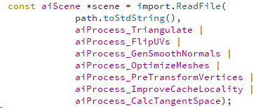
Tangent space matrix (TBN) - Calculation
We can have assimp do the hard work for us.

Slide 15
Tangent space matrix (TBN) - Calculation
We can have assimp do the hard work for us.
// process vertices
for(unsigned int i = 0; i < mesh->mNumVertices; i++)
{
vertices.push_back(mesh->mVertices[i].x);
vertices.push_back(mesh->mVertices[i].y);
vertices.push_back(mesh->mVertices[i].z);
vertices.push_back(mesh->mNormals[i].x);
vertices.push_back(mesh->mNormals[i].y);
vertices.push_back(mesh->mNormals[i].z);
if(mesh->mTextureCoords[0])
{
hasTexCoords = true;
vertices.push_back(mesh->mTextureCoords[0][i].x);
vertices.push_back(mesh->mTextureCoords[0][i].y);
}
if(mesh->mTangents != nullptr && mesh->mBitangents != nullptr)
{
hasTangentSpace = true;
vertices.push_back(mesh->mTangents[i].x);
vertices.push_back(mesh->mTangents[i].y);
vertices.push_back(mesh->mTangents[i].z);
vertices.push_back(mesh->mBitangents[i].x);
vertices.push_back(mesh->mBitangents[i].y);
vertices.push_back(mesh->mBitangents[i].z);
}
}

Slide 16
Normal mapping (vertex shader)
#version 330 core
layout(location=0) in vec3 position;
layout(location=1) in vec3 normal;
layout(location=2) in vec2 texCoords;
layout(location=3) in vec3 tangent;
layout(location=4) in vec3 bitangent;
uniform mat4 projectionMatrix;
uniform mat4 worldViewMatrix;
out Data
{
vec3 tangentLocalspace;
vec3 bitangentLocalspace;
vec3 normalLocalspace;
vec2 texCoords;
} VSOut;
void main(void)
{
VSOut.tangentLocalspace = tangent;
VSOut.bitangentLocalspace = bitangent;
VSOut.normalLocalspace = normal;
VSOut.texCoords = texCoords;
mat4 wvp = projectionMatrix * worldViewMatrix;
gl_Position = wvp * vec4(position, 1.0);
}

Slide 17
Normal mapping (fragment shader)
// Uniform inputs
uniform mat4 worldViewMatrix;
uniform sampler2D normalMap;
// Inputs from VS
in Data {
vec3 tangentLocalspace;
vec3 bitangentLocalspace;
vec3 normalLocalspace;
vec2 texCoords;
} FSIn;
void main(void)
{
// Tangent to local (TBN) matrix
vec3 T = normalize(FSIn.tangentLocalspace);
vec3 B = normalize(FSIn.bitangentLocalspace);
vec3 N = normalize(FSIn.normalLocalspace);
mat3 TBN = mat3(T, B, N);
// Convert normal from tangent space to local space and view space
vec3 tangentSpaceNormal = texture(normalMap, FSIn.texCoords).xyz * 2.0 - vec3(1.0);
vec3 localSpaceNormal = TBN * tangentSpaceNormal;
vec3 viewSpaceNormal = normalize(worldViewMatrix * vec4(localSpaceNormal, 0.0)).xyz;
// ...
}

Slide 18
From height map to normal map
QImage bumpMap = myMaterial->bumpTexture->getImage();
QImage normalMap(bumpMap.size(), QImage::Format_RGB888);
const int w = normalMap.width();
const int h = normalMap.height();
const float bumpiness = 2.0f;
for (int y = 0; y < h; ++y) {
for (int x = 0; x < w; ++x) {
// surrounding indices
const int il = (x + w - 1) % w;
const int ir = (x + 1) % w;
const int ib = (y + 1) % h;
const int it = (y + w - 1) % h;
// surrounding pixels
float tl = qRed( bumpMap.pixel(il, it) ) / 255.0f; // top left
float l = qRed( bumpMap.pixel(il, y) ) / 255.0f; // left
float bl = qRed( bumpMap.pixel(il, ib) ) / 255.0f; // bottom left
float t = qRed( bumpMap.pixel(x, it) ) / 255.0f; // top
float b = qRed( bumpMap.pixel(x, ib) ) / 255.0f; // bottom
float tr = qRed( bumpMap.pixel(ir, it) ) / 255.0f; // top right
float r = qRed( bumpMap.pixel(ir, y) ) / 255.0f; // right
float br = qRed( bumpMap.pixel(ir, ib) ) / 255.0f; // bottom right
// sobel filter
const float dX = (tl + 2.0 * l + bl) - (tr + 2.0 * r + br);
const float dY = (bl + 2.0 * b + br) - (tl + 2.0 * t + tr);
const float dZ = 1.0/bumpiness;
// normal vector
QVector3D n(dX, dY, dZ);
n.normalize();
n = n* 0.5 + QVector3D(0.5f, 0.5f, 0.5f);
normalMap.setPixelColor(x, y, QColor::fromRgbF(n.x(), n.y(), n.z()));
}
}

Slide 19
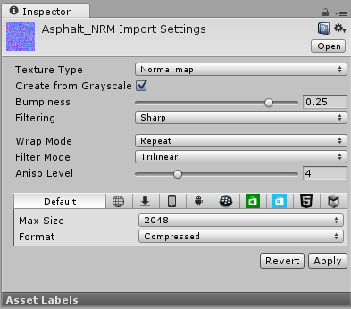
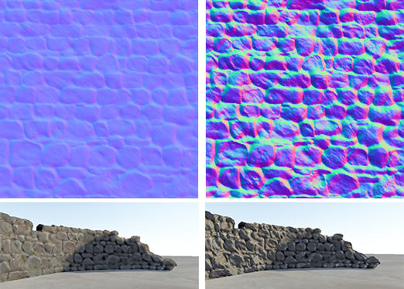
Bumpiness
Bumpiness can be changed modifying the z component of the normal map

Slide 20
Tutorials
A couple of resources:
http://www.opengl-tutorial.org/es/intermediate-tutorials/tutorial-13-normal-mapping/
https://learnopengl.com/Advanced-Lighting/Normal-Mapping

